Slide 1
Facial Recognition Linear Algebra Final Project
Steve Barry, Kunal Shukla, Anupriya Thirumurthy, Hena Lee
June 1, 2018

Slide 2
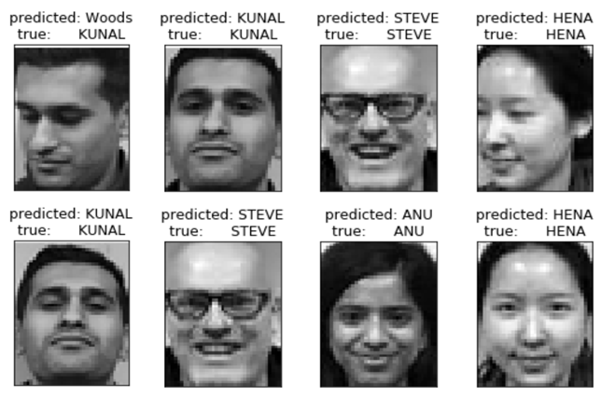
Introduction - Facial Recognition
Leveraged a Scikit Learn Project
http://scikit-learn.org/stable/auto_examples/applications/plot_face_recognition.html
Took 10 pictures each of ourselves and reduced our images pixel size
Modified code to include our images in the dataset
Next in code we converted to grayscale and then ran PCA against the data
All to further reduce dimensionality and save computational time
Trained and classified our dataset using Support Vector Machines (SVM)
Lastly we tweaked the code so that our images were used in predictions

Slide 3
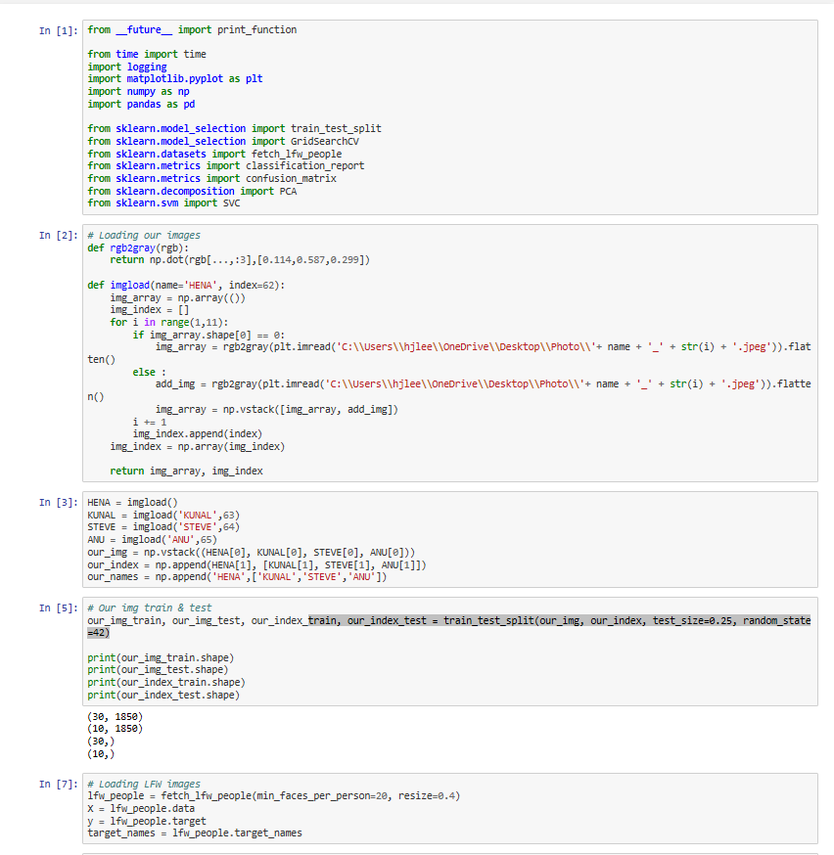
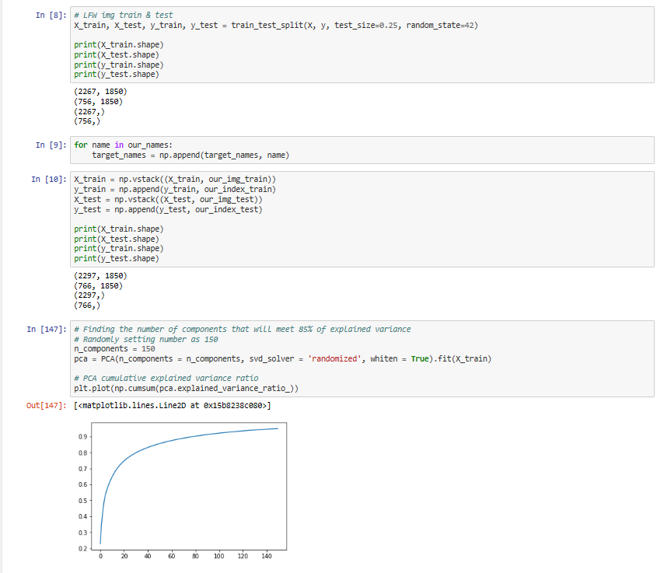
Here’s how - the complete code in python

Slide 4
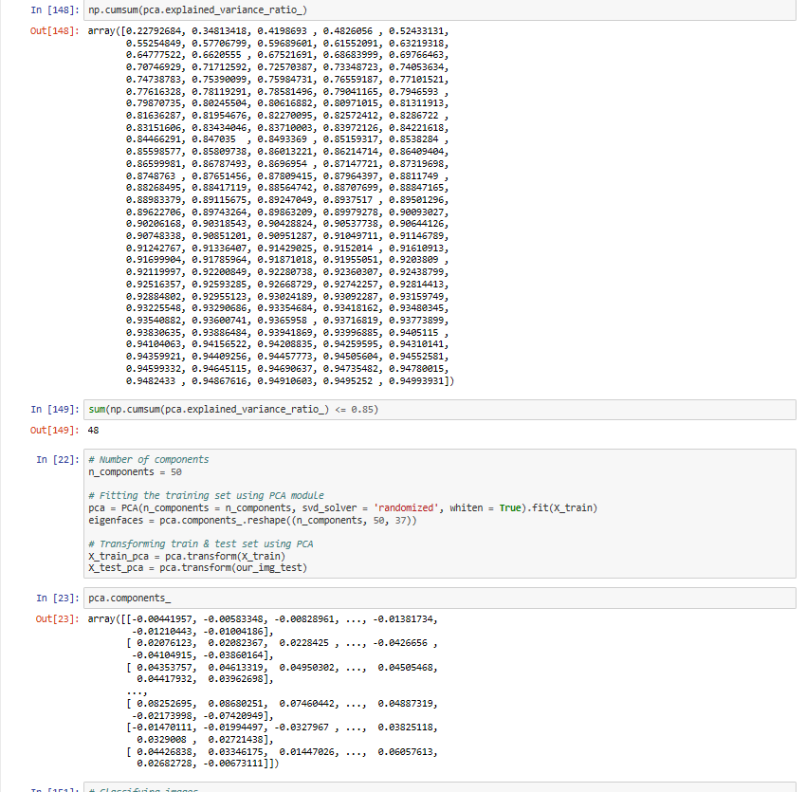
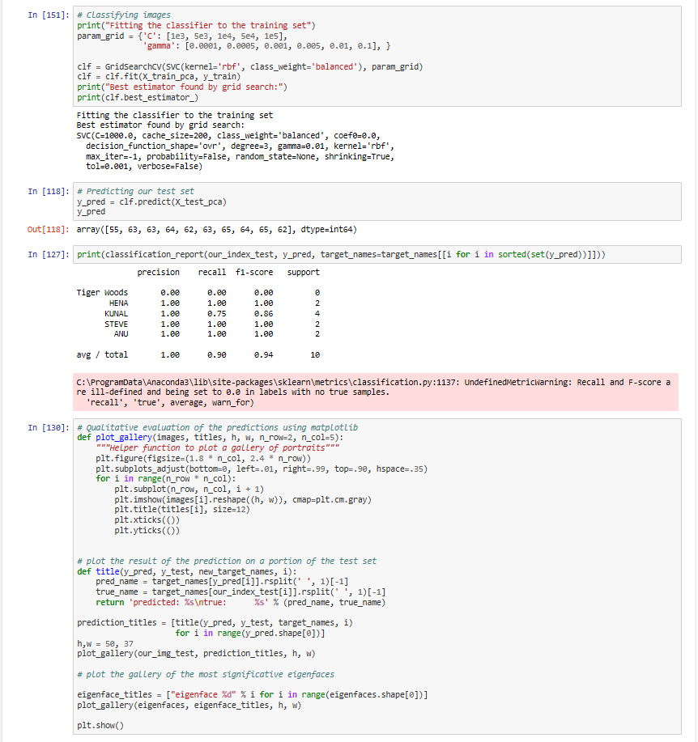
Python code - page 2

Slide 5
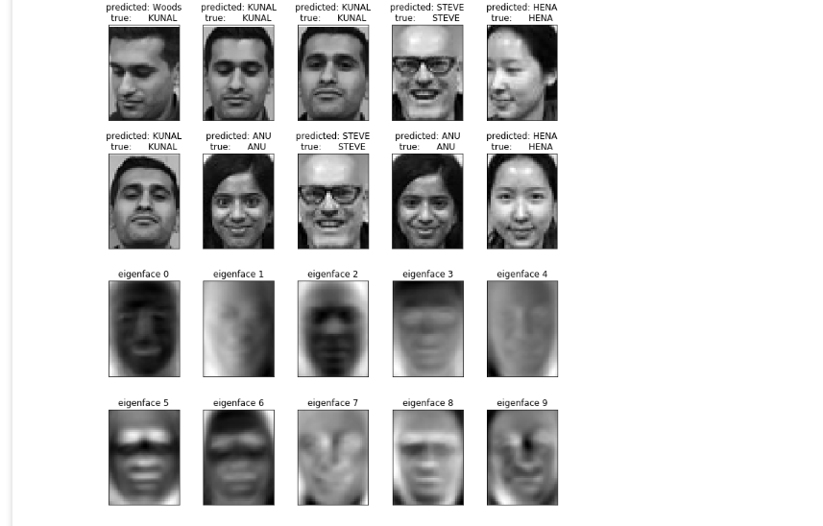
Python Code Final Output

Slide 6
What is one possible implementation of Facial Recognition?
Support Vector Machines (SVM)
Machine learning algorithm that can be trained to correctly classify a person in an image (among other uses)
The SVM needs to be trained using images
Each image is m x n pixels – this can be represented by a mn x 1 vector
mn can be a large number – training a SVM using mn-dimensional images can become very computationally expensive
Sources: http://scikit-learn.org/stable/auto_examples/applications/plot_face_recognition.html
https://onionesquereality.wordpress.com/2009/02/11/face-recognition-using-eigenfaces-and-distance-classifiers-a-tutorial/

Slide 7
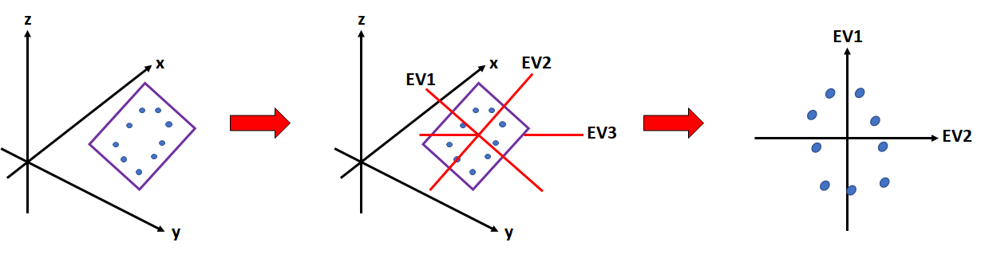
Problem Statement
How do we reduce the dimensionality of the mn dimensional images to train the SVM with a lower computational cost, while retaining the most important aspects of the images?
We can use Principal Component Analysis to reduce the dimensionality of the images:
Source: https://georgemdallas.wordpress.com/2013/10/30/principal-component-analysis-4-dummies-eigenvectors-eigenvalues-and-dimension-reduction/

Slide 8
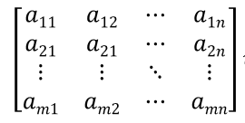
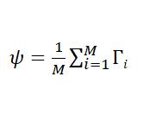




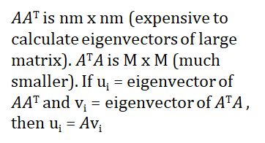


Application of Principal Component Analysis
We want to find the Principal Components, or axes of maximal variance, to construct a lower dimensional space to project our image data onto
This lower dimensional space will allow the SVM to perform its calculations much faster
But what exactly are we finding the Principal Components of? Covariance Matrix
1. Convert each image to a vector of pixel values
2. Find the “average” face vector ψ. Subtract the mean face from each face vector
3. Find the Covariance Matrix C. Compute eigenvectors of C
Source: https://onionesquereality.wordpress.com/2009/02/11/face-recognition-using-eigenfaces-and-distance-classifiers-a-tutorial/

Slide 9
Putting it all together
Based on user input, we select the x largest eigenvectors of the Covariance Matrix
We then project our image data in mn-dimensional space onto the smaller x-dimensional space constructed using the eigenvectors
Each image projection is a linear combination of the eigenvectors
Since we are projecting the image data onto eigenvectors, we will still retain the “facial features” that are most distinguishable relative to the “average” face
The most distinguishable facial features may not necessarily be recognizable by humans (i.e., nose or eye)
The SVM can now be implemented at a much lower computational cost

Slide 10
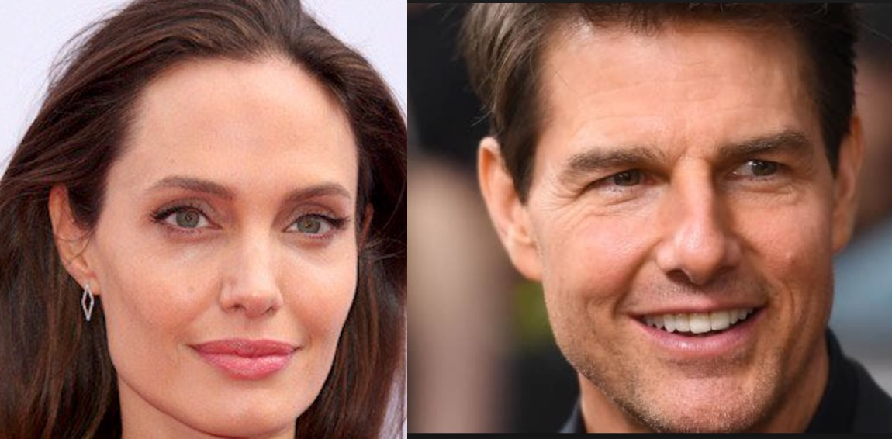
Labelled Faces in the Wild
>13,000 images of faces from 5,749 people
4,100 people have 1-2 images - unsuitable candidates for training a face classifier
Remaining 1,650 people have >2 images
Faces are centered
Source: http://vis-www.cs.umass.edu/lfw/

Slide 11
Construction And Data Preparation
Gathering raw images
Running a face detector (Viola–Jones)
Eliminating duplicate images
Labelling the detected people
Cropping and re-scaling the detected faces (50 x 37=1850)
Forming training and testing pairs
Source: http://vis-www.cs.umass.edu/lfw/lfw.pdf

Slide 12
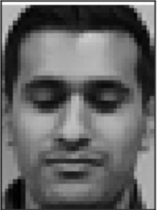
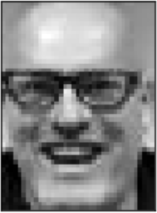
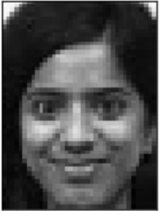
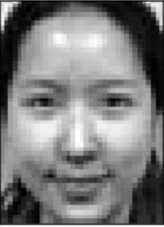
Images
Represented as vectors
a₁, a₂, … a_{50x37}
b₁, b₂, … b_{50x37}
c₁, c₂, … c_{50x37}
d₁, d₂, … d_{50x37}

Slide 13
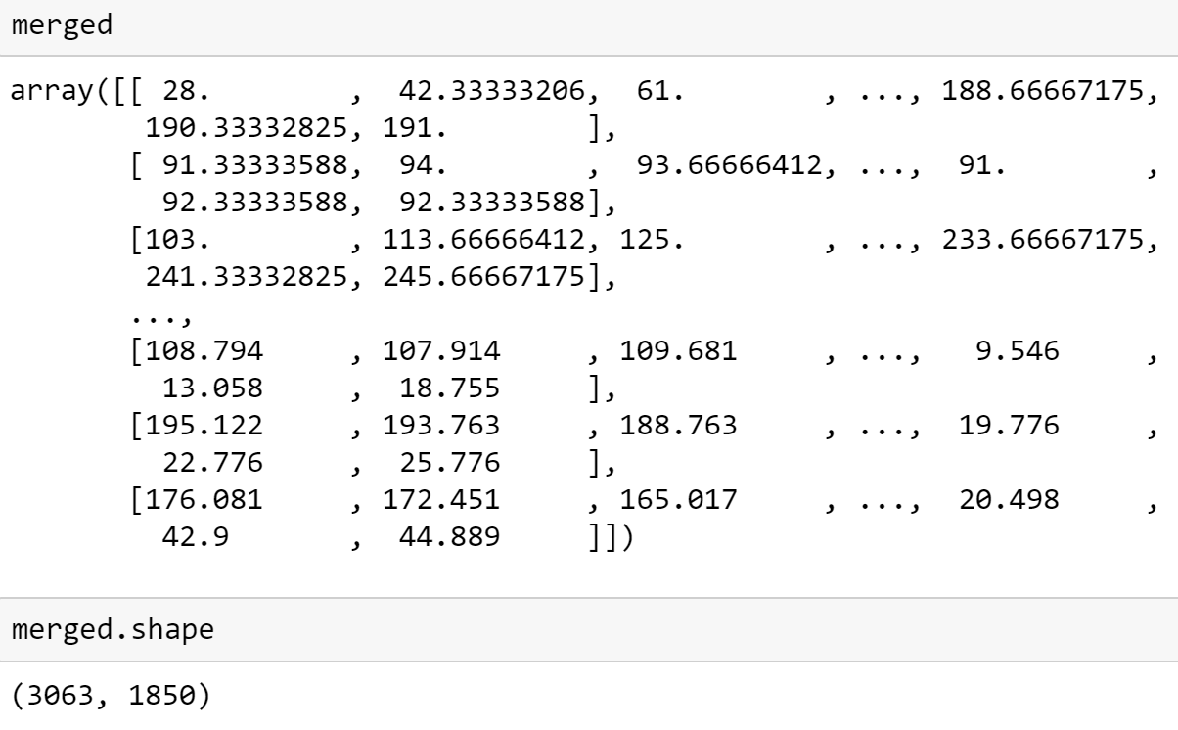
Composition Details
Final details of dataset:
Number of images: 13,050
Number of people: 5,753
Number of features: 1,850 (50 x 37 pixels after resizing and cropping)
Chose images where person occurred at least 20 times in data set

Slide 14
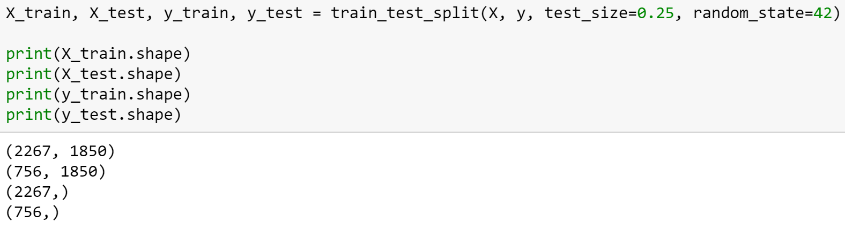
Training & Test Set
X - images (LFW images + our images) - 3,063 in total
y - index of people (0 ~ 65) - 66 in total

Slide 15
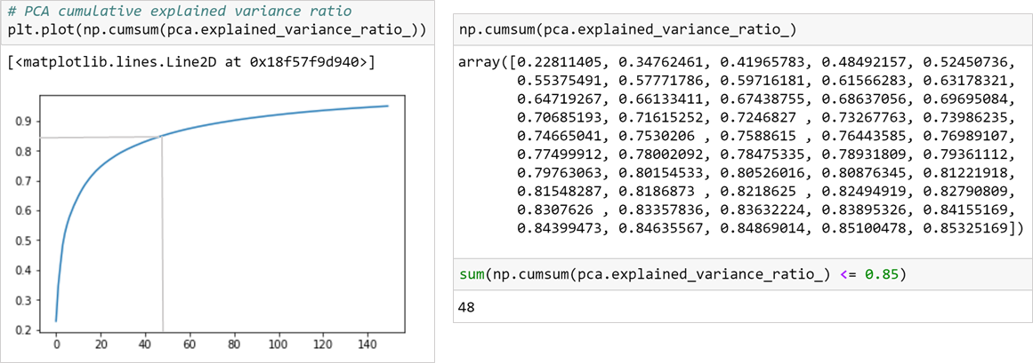
PCA Components
Number of principal components = 50

Slide 16
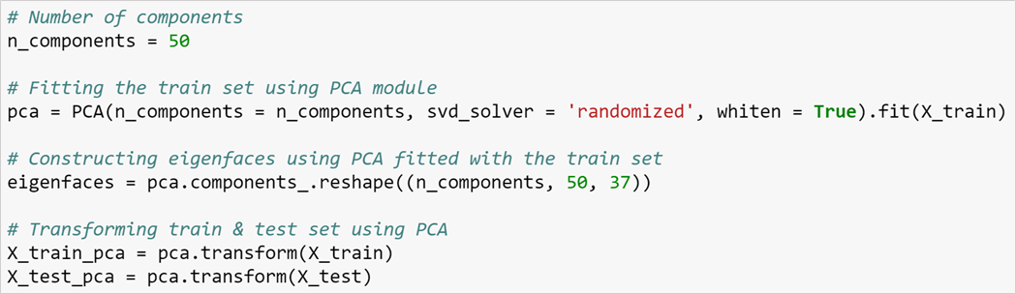
PCA Components
Reducing dimension of 1,850 to 50
Fitting the training set and constructing eigenfaces using PCA module
Transforming the training and test set using PCA

Slide 17
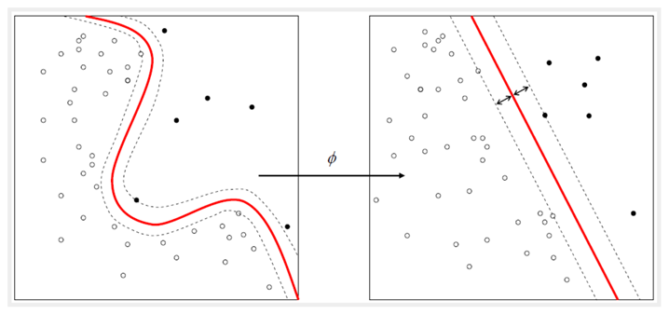
Classification (SVM)
Using SVM to classify images
Training classificaion model with the transformed training set
Predicting people’s names on the transformed test set of images
Source: https://ipython-books.github.io/85-using-support-vector-machines-for-classification-tasks/

Slide 18
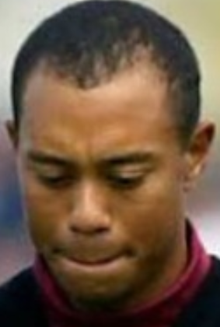
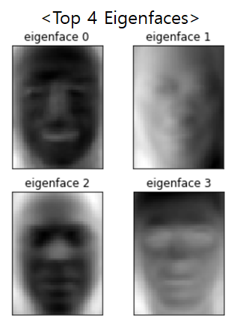
Results
Average recall is 90%
Limitations
Images need to be in the same size (ex. h:50, w:37) & grayscale
Faces should be centered
Clean backgrounds

Slide 19
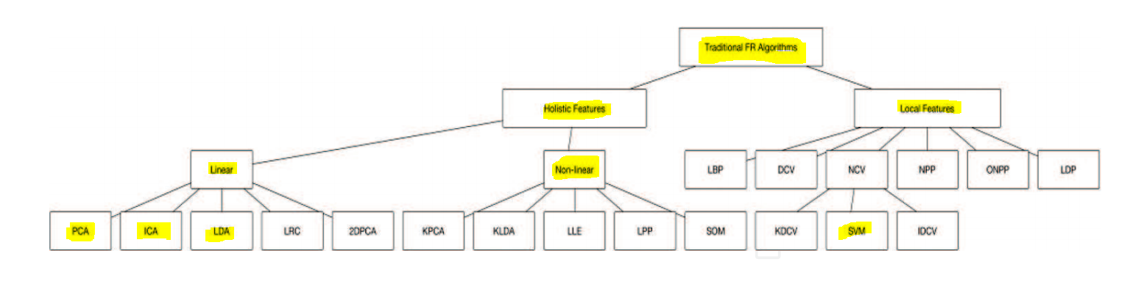
Future Improvements -
Traditional Techniques for Face-Recognition
Classical Face Recognition Algorithms1
PCA/SVM, Logistic Regression, and many others
Suffers from large variations in lighting conditions, facial expressions and other factors
1 - Waldemar Wójcik, Konrad Gromaszek and Muhtar Junisbekov: ‘Face Recognition: Issues, Methods and Alternative Applications’ Chapter 2,
Published: July 6th 2016, http://dx.doi.org/10.5772/62950

Slide 20
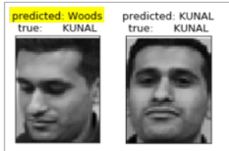
Future Improvements -
How to Improve Technique Alternatives for Face-Recognition
Artificial Neural Networks (ANN)1
Ideal solution for recognizing images (faces) with partial distortion and poor illumination
Computationally efficient, but requires a large training set
Gabor Wavelet Method2
Uses high dimensionality
Computationally expensive and not for real-time
Face Descriptor Method1
Learns the most discriminant local features that minimize difference between images of the same individual and maximize those differences from other people
3D Based Face Recogniton1
3D is better then 2D, but extremely expensive computationally
1 - Waldemar Wójcik, Konrad Gromaszek and Muhtar Junisbekov: ‘Face Recognition: Issues, Methods and Alternative Applications’ Chapter 2,
Published: July 6th 2016, http://dx.doi.org/10.5772/62950
2 - Daugman, John. Computer Vision Lecture Series, University of Cambridge

Slide 21
Meet the Team
Kunal - Project managed and analyzed application of linear algebra
Anu - Broke down the code into the math and logic behind it
Hena - Modified the data sets and rewrote the code to personalize
Steve - Researched initial methods/code and alternatives to approach
Combined Team Efforts
Method and code discovery
Research and logic behind PCA and SVM classification
Frequent team collaboration
Presentation and preparation

